Slide 1


Vulnerability Assessment
BetterBe - Transforming automotive leasing worldwide
UT Team Group 2 / 01. 01. 2022

Slide 2







UT Team
Kristen Phan
Nilay Prashant Naik
Zahra van Egdom
MSc Student in Business IT
Specialization: Enterprise Archi & IT Management + Cloud Technology
MSc Student in Business IT
Specialization: Data Science & Business
MSc Student in Business IT
Specialization: Enterprise Archi &
IT Management
Vibha Ravindra
Sam Tran
Dovydas Ožiūnas
Abdul Raqeeb
MSc Student in Business IT
Specialization: Data Science & Business
MSc Student in Business IT
Specialization: Data Science & Business
MSc Student in Business IT & Information Systems
MSc Student in Business IT

Slide 3

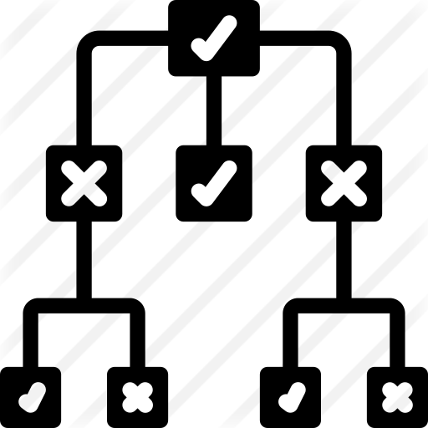
Agenda
About BetterBe
Problem Statement
Hacker Profiling
Hackers on MITRE ATT&CK Matrix
Hackers on Network Topology
Recommendations

Slide 4
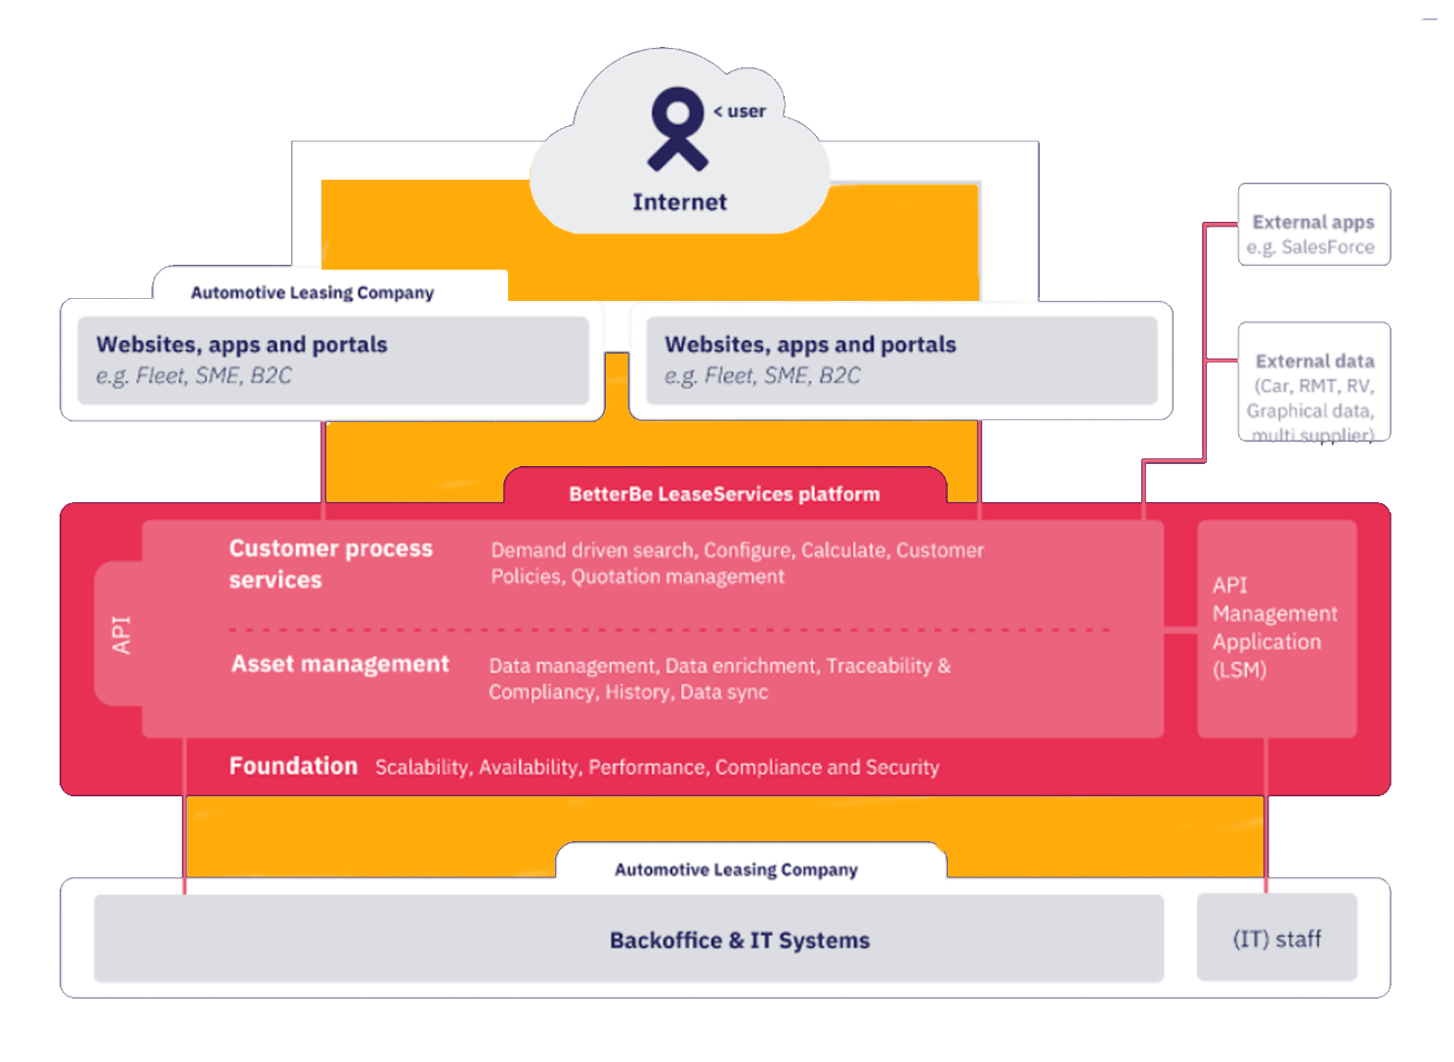
About BetterBe
Problem Statement
Hacker Profiling
MITRE ATT&CK Matrix
Attack Trees + Network Topology
Recommendations
About BetterBe: Business Processes
BetterBe is a software company founded in 1999 that provides a customized API-based Software-as-a-Service solution called BLS to automotive leasing companies.
Currently serving 8 of the top 10 leasing companies in Europe
BLS allows clients to :
> Search car data real time using a vast amount of data sources
> Configure ready-to-order cars based on customer preferences
> Calculate pricing real time
Source: BetterBe’s internal slide deck

Slide 5
About BetterBe
Problem Statement
Hacker Profiling
MITRE ATT&CK Matrix
Attack Trees +
Network Topology
Recommendations
About BetterBe: Stakeholder Analysis
The main business process is the BetterBe Leasing Service (BLS). The stakeholders involved are:
BetterBe
BetterBe clients (MeinAuto, Volkswagen, Arval…)
Regulators (Data Protection Authorities)
Data providers
add citations here
Notes:
The BLS takes 3 inputs: leasing company quota calculation structure, Vehicle Data from DataProviders, and Financial rules provided by LCs.

Slide 6
About BetterBe
Problem Statement
Hacker Profiling
MITRE ATT&CK Matrix
Attack Tree +
Network Topology
Recommendations
Research Questions & Project Methodology
Who
can do
What
and
How
research questions
Hacker Profiling
Novice hackers (low motivation)
Cyber criminals (medium)
Corporate espionage (high)
MITRE ATT&CK
Framework
Attack Tree
+
Mock-up
Network Topology
(mitigation techniques)
methodology
Warikoo,. (2014). Proposed Methodology for Cyber Criminal Profiling. Information Security Journal: A Global Perspective. 23. 10.1080/19393555.2014.931491.

Slide 7

About BetterBe
Problem Statement
Hacker Profiling
MITRE ATT&CK Matrix
Attack Tree +
Network Topology
Recommendations
Hacker Profiling: Novice (Low Motivation)
Pleaded guilty as a creator and operator of multiple DDoS IoT botnets, including Satori.
Motives:
Go after attention + money, not necessarily after BetterBe
Want to prove their abilities and gain respect in the hacking community
Personality Traits:
Brash + greedy
Hackers in Action:
Name: Kenneth Schuchman
Age: 21
MITRE Attack Category | MITRE Attack Technique | Attack Tools | Impact on BB | Impact on BB Clients | Impact on Lessees
Impact | Network denial of service | Botnets | X | X
Resource development | Acquire Infrastructure: Botnet | Stress testers | X | X
Impact | Endpoint denial of service | Botnets | X | X
Reconnaissance | Active scanning | Security scanners e.g. Zenmap to find open ports | X
Collection | Adversary-in-the-middle | Packet sniffers e.g. Wireshark | X
Motivation Level
Low
Skill + Resource Level
Low
Attack Severity
Low - Medium

Slide 8

About BetterBe
Problem Statement
Hacker Profiling
MITRE ATT&CK Matrix
Attack Tree +
Network Topology
Recommendations
Hacker Profiling: Cyber Criminals (Medium Motivation)
I believe in a world where all these things can happen, even if I have to do them myself
Motives:
Target SMEs with limit resources yet high-profile clientele for financial gain + intellectual property (e.g. source code)
Personality Traits:
Moderately skilled + highly motivated
Hackers in Action:
Name: Adrian Lamo
Age: Deceased
MITRE Attack Category | MITRE Attack Technique | Attack Tools | Impact on BB | Impact on BB Clients | Impact on Lessees
Credential Access | Credential Stuffing | Sentry MBA, Account Hitman, Vertex and Apex. | X | X
Initial Access | Exploit Public-Facing Application; Trusted Relationship; External Remote Services: | SQL injection tools (e.g. SQL map, Jsql INjection, BBQSQL, DSSS, EXPLO, BLISQY) | X | X
Persistence; Privilege Escalation | SSH Authorised Keys; Access Token Manipulation | Mimikatz and Windows credential editor | X
Impact | Data Encrypted for Impact (Ransomware) Endpoint Denial of Service | Solarwinds sem tool, HULK, LOIC, Xoic, Slowloris | X | X
Motivation Level
Medium - High
Skill + Resource Level
Medium
Attack Severity
Medium - High
Notes:
Credential Access: This would most commonly be the first step to attack and get into the system. Assumption: credentials used to access the system is the same as credentials for personal use. Attackers aim at stealing LC data, such as cost structure, margin, residual value. These are key inputs for BLS to calculate leasing price. LC data can be from LC currently uses BLS or previously used BLS.
Initial Access: This can be used by (competing) LCs or Final Customers to get into Betterbe system because BetterBe do not have a web-app to directly query data.
Persistence and Privilege Escalation: Attackers aim to create a backdoor in BB’s system or gain higher level of access. This can be achieved if they gain admin access to create new user account, or they attack the VMs to install malware code
Impact: Attackers aim to make BetterBe service (BLS) not responding (either in the internal system or API calls), which eventually causes service disruption and economic loss for large customer of BetterBe (such as Volkswagen)

Slide 9

About BetterBe
Problem Statement
Hacker Profiling
MITRE ATT&CK Matrix
Attack Tree +
Network Topology
Recommendations
Hacker Profiling: Corporate Espionage (High Motivation)
In the hacking world, security is more of a response than a proactive measure. They wait for hackers to attack and then they patch, based on the attacks.
Motives:
Hires cyber crime syndicates to target BetterBe for financial gain + reputation damage e.g. a leasing company wants to tamper with the pricing calculation for its competitor
Personality Traits:
Highly skilled + motivated
Hackers in Action:
Name: Michael Calce
Age: 38
MITRE Attack Category | MITRE Attack Technique | Attack Tools | Impact on BB | Impact on BB Clients | Impact on Lessees
Initial access & Lateral movement | Phishing & remote service session hijacking | Advanced Peristent Threat,APT, in combination with spear-phishing for BYOD | X | X | X
Impact | Endpoint & network denial of service | Generator of slow Denial-of Service attacks (e.g. Slowloris) | X | X
Motivation Level
High
Skill + Resource Level
High
Attack Severity
Medium - High
https://bit.ly/3rrhicb, https://bit.ly/3nwbSvh, https://bit.ly/3KgUXGP,, https://bit.ly/34Lgy9Y

Slide 10
Executive Summary
Problem Statement
Hacker Profiling
MITRE ATT&CK Matrix
Attack Tree +
Network Topology
Recommendations
Hackers on MITRE ATT&CK Matrix
Recon-
naissance
Resource
Development
Initial Access
Privilege Escalation
Credential Access
Lateral Movement
Persistence
Collection
Impact
Active scanning
Acquire infra-
structure
Phishing
SSH authorized keys
Access token manipulation
Credential stuffing
Remote service session hijacking
Adversary-
in-the-
middle
Endpoint denial-of-
service
Exploit public-facing application
Network denial-of-
service
Trusted relations
External remote services
MITRE attack technique deployed by novice
MITRE attack technique deployed by cyber crime syndicates
MITRE attack technique deployed by cyber criminals
MITRE attack technique deployed by more than one hacker types
https://attack.mitre.org/tactics/enterprise/

Slide 11
About BetterBe
Problem Statement
Hacker Profiling
MITRE ATT&CK Matrix
Attack Tree +
Network Topology
Recommendations
Hackers on Attack Tree
Public IP scanning to find public endpoints + open ports
Exploit outdated routers/ vulnerable hosts to infiltrate private network
Private IP scanning to find private endpoints + open ports
DoS attacks on public and private endpoints using botnets > BLS service unavailable
Objective of novice/ corporate espionage
End
Phishing to steal credentials
Credential stuffing to exploit found ports
Gain access to remote servers
Privilege escalation/ brute-force to move laterally across network
Create backdoors to achieve persistence (e.g. new credentials)
Start
reinforces
Install ransomware to encrypt production + backup data > pay ransom to regain access
Objective of cyber criminals
End
Install worms to exfiltrate data > BLS service unavailable
Objective of corporate espionage
End
Credential stuffing to gain access to source code repository
Tamper with pricing formula > cause leasing competitors to operate at loss or lose customers
Objective of corporate espionage
End
* T-Mobile hack involved exposed router

Slide 12





About BetterBe
Problem Statement
Hacker Profiling
MITRE ATT&CK Matrix
Attack Tree +
Network Topology
Recommendations
Network Topology: Mitigation Techniques
BB data center n network
IP masquerading
DoS protection
BB data center 1 network
2
1
Robust testing against SQL injection attacks + data encryption at rest
Client 1 subnet
5
Traffic monitoring + TLS 1.3 for perfect forward secrecy
BLS instance 1
BLS instance n
External service
2
Vehicle inventory
3
Flood gate
BLS
BLS
HTTPS
Database
Database
NAT gateway
Database
Key rotation
+ key lifecycle mgmt
6
VM (e.g. private IPs) + network configuration (e.g. firewall rules)
Leasing portal
Load balancer
Client n subnet
2
Client n subnet
Mgmt subnet
9
Load testing
BLS instance 1
1
BLS instance n
Key Manager
External service
LDAP
BLS
BLS
Certificate Authority
Infra-as-
code
Multi-factor authn
+ log monitoring to detect and auto delete unauthorized roles created
+ user/ service account mgmt
Database
Database
Database
Database
4
Authn/ authz
7
Password policies
4
BB corporate network
Network segmentation
External service
Traffic lockdown: no traffic allowed between different client subnets and between BLS instances in the same subnet
8
8
Data center mgmt subnet
CI/CD subnet
Misc. subnet
Code repository
Printer
Disaster recovery plan
Database
Backup subnet
Secure VPN protocol (e.g. IPSec) + properly configured routing table
BB employee desktop
BB employee desktop
BB employee desktop
BB employee desktop
3
Backup
Database
VPN
Mitigation technique
MITRE attack technique
DOS attack
Active scanning
BB employee laptop
1
Adversary-in-the-middle
Credential stuffing
Exploit public-facing App
SSH authorized keys
Trusted relationships
Remote service session hijacking
Acquire infrastructure
3
5
7
9
https://attack.mitre.org/tactics/enterprise/
2
4
6
8

Slide 13
About BetterBe
Problem Statement
Hacker Profiling
MITRE ATT&CK Matrix
Attack Tree +
Network Topology
Recommendations
Recommendations
Cybersecurity Is a Journey, Not a Destination
Network
Assessment
Hacker Profiling
Attack Tree + Network Topology
Validate the proposed hacker profiles (‘who’) and hacking techniques (‘what’)
Validate attack tree + proposed mitigation techniques to safeguard against identified hacking techniques (‘how’)
Hacker Profiling
Implementation
Improvement
Implementation
Monitoring
Prioritize and implement best practices based on cost-benefit analysis
Monitor new threats and emerging security technologies
Monitoring

Slide 14
